Slide 1
Unit 3 Chapter 1B
Earlier, we considered whether countries with higher levels of consumption of a particular food had higher death rates due to heart disease. Researchers would be interested to find out whether the higher death rates were in some way explained by the higher consumption of the foodstuff.
In this situation, we say that the consumption of the food is the explanatory variable, also known as the independent variable or predictor variable.
Were the higher death rates due to heart disease a response to the higher levels of consumption of the food? We say that the death rate is the response variable, also called the dependent variable or predicted variable.
When investigating relationships in bivariate data, the explanatory variable is the variable used to explain or predict a difference in the response variable.

Slide 2
Unit 3 Chapter 1B
If you find it difficult to identify which variable is the explanatory variable (independent) and which is the response variable (dependent) it can help to ask:
Which variable explains differences in the other?
Which variable would be used to predict the other?
Which occurs first?
Does the balance of male/female MPs depend upon the party the MP is in?
Explanatory variable: Political party
Response variable: Whether the MP is male or female
Can the choice of mode of transport be explained by gender?
Explanatory variable: Gender
Response variable: Mode of transport
Can preferred type of movie be explained by age?
Explanatory variable: Age
Response variable: Preferred type of movie
Does high blood pressure increase the risk of a heart attack?
Explanatory variable: Blood pressure
Response variable: Risk of heart attack

Slide 3
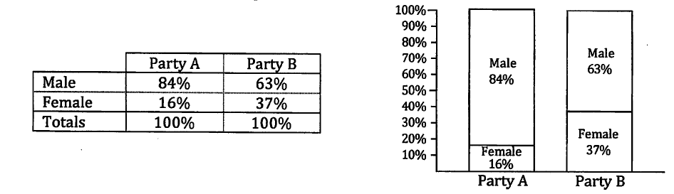
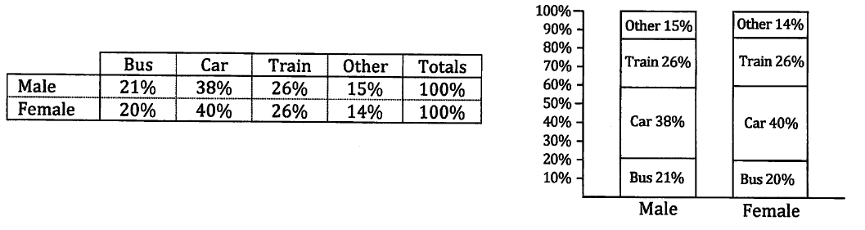
Unit 3 Chapter 1B
In the MPs situation, we considered whether the party an MP was in would explain the male/female balance. The political parties formed the explanatory variable and gender the response variable. The table gave the political parties as columns and we created column percentages before drawing our column graph.
In this situation, we are considering whether gender explains any variation in choice of mode of transport. Now, gender is the explanatory variable and mode of transport is the response variable. The table gives us gender as rows, so we find row percentages before drawing our column graph.
If the explanatory variable uses the rows to show its different categories, use row percentages.
If the explanatory variable uses the columns to show its different categories, use column percentages.

Slide 4
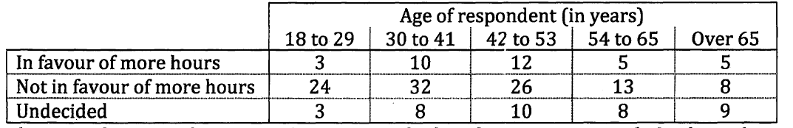
Unit 3 Chapter 1B Example 3
A number of people were asked whether they favoured increasing the number of driving hours a learner driver must complete before gaining their license, were not in favour or were undecided. The results, by age of respondent, led to the following table.
These results are to be used to investigate whether the way a person feels about this issue can be explained by their age.
Which is the explanatory variable and which is the response variable?
We are looking at whether the answer to the survey can be explained by age. Age is the explanatory variable and the answer is the response variable.

Slide 5
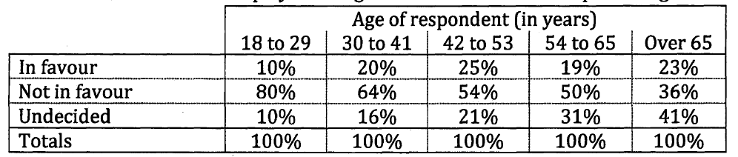
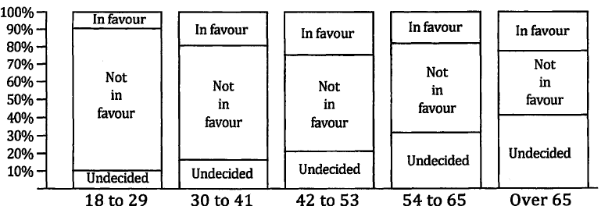
Unit 3 Chapter 1B Example 3
b) Draw a table showing either row or column percentages (as appropriate) and create a proportional column graph.
Column percentages as the explanatory variable is on the columns.

Slide 6
Unit 3 Chapter 1B Example 3
Now try Exercise 1B
c) Comment on any association between the variables, explaining your reasoning and describing the situation.
The change in the proportions of answers as we move across age categories suggests that there is an association between the response and age.
Whilst in each age category, the ‘not in favour’ is larger than the ‘in favour’, the proportion of ‘not in favour’ decreases as the age category increases.
The proportion of ‘undecided’ increases as age category increases, from only 10% of 18 to 29s up to 41% for over 65s.
The proportion ‘in favour’ is least in the age category 18 to 29 (10%) which is roughly half the proportion of ‘in favour’ responses from the other age categories.

